Slide 1


Minor Project
Title:
Predicting Human-Animal Conflict
Presented by:
Panchika Gupta, R2142220121, B.tech CSE (CCVT)
Rakshan Sharma, R2142220142, B.tech CSE (CCVT)
Kunal Sinha, R2142220107, B.tech CSE (CCVT)
Om Vats, R2142220269, B.tech CSE (Dev-Ops)
Guided by:
Dr. Saurabh Shanu
Assistant Professor
Selection Grade
School of Computer Science

Slide 2
Content
Introduction
Problem Statement
Motivation
Objective
Methodology
Technology Stack
Data Processing
Habitat Sustainablity Index
Conflict Risk Zones and Hotspots
Streamlit Dashboard
References

Slide 3
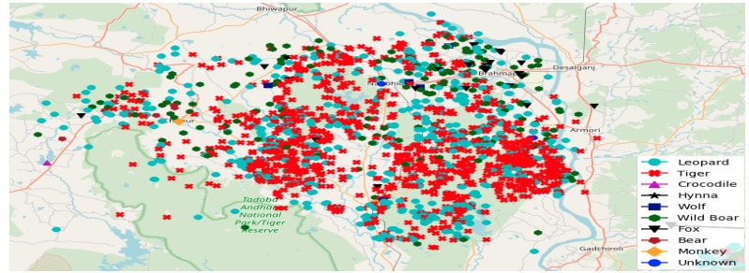
1. Introduction
What is Human-Animal Conflict (HAC)?
Human-Animal Conflict (HAC) arises when wildlife and human activities overlap, leading to economic losses such as crop destruction, livestock predation, property damage, and the death of humans or animals. Ecological, economic, and social parameters such as habitat destruction, climate change, and urban expansion have significantly increased these conflicts, thereby endangering biodiversity and human civilizations.
Traditional measures for mitigating such conflicts, such as fences, patrols, or animal relocation, seem not only ineffective and reactive but also extremely resource-intensive, given that an increasing human population is still expanding into wildlife habitats. Such approaches do not always succeed in averting conflicts before they appear, causing delayed responses and thus economic losses.
Figure 1: GPS plot of human-animal conflicts in the Bramhapuri Forest Division, India from 2014 to 2017

Slide 4
1. Introduction (contd.)
Technology as a Solution !
Taking the opportunity for evolving human-animal conflict management using GIS and Machine learning towards reaching predictive capability. Use innovative ML technologies to predict potential hotspots and provide actionable geospatially mapped insights.
Through this technology-driven approach, we strive to:
Minimize casualties and economic losses by predicting and preventing conflicts.
Enhance conservation efforts while maintaining ecological balance.
Promote human-wildlife coexistence using data-backed decision-making.
Our goal is to shift from reactive conflict management to a proactive and predictive approach, ensuring both wildlife conservation and human safety.
By integrating cutting-edge technologies, our project presents a scalable and efficient model for sustainable wildlife conservation and human safety.

Slide 5
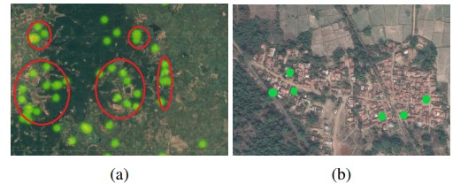
2. Problem Statement
Human-wildlife conflict is an escalating concern, particularly in regions where human settlements encroach upon natural habitats. These conflicts often lead to loss of biodiversity, damage to crops and property, and even casualties on both sides. The lack of predictive tools to identify high-risk areas hinders proactive conflict mitigation strategies. There is a pressing need for a data-driven system that can forecast potential conflict zones, assess habitat suitability, and empower stakeholders—such as conservationists, local communities, and policymakers—with actionable insights.
Figure 2: Green dots highlight individual conflicts.
(a) Clustered conflicts (highlighted in red) appear near the intersection of terrains. The darker green areas denote dense forested areas, while the lighter areas have sparse vegetation.
(b) Conflicts at the boundary of human settlements and forests.

Slide 6
3. Motivation
With growing anthropogenic pressures, wildlife habitats are increasingly overlapping with human settlements, leading to frequent and often severe conflicts. Traditional reactive approaches fail to prevent these incidents. Our project is motivated by the need to shift from reactive to proactive conflict management by leveraging data science, ecological indicators, and interactive technology. This system aims to support:
Conservationists, in identifying and prioritizing critical habitats.
Local communities, in preparing for and mitigating risks.
Policymakers, in formulating informed land-use and conservation policies.

Slide 7
4. Objective
To build an interactive system that predicts human-wildlife conflict risk using
habitat suitability analysis and machine learning.
Sub-objectives:
Preprocess and normalize environmental data.
Calculate Habitat Suitability Index (HSI) using WSM.
Generate synthetic conflict data to supplement real data.
Train a machine learning model for conflict prediction.
Develop a Streamlit dashboard for visualization and simulation.

Slide 8
5. Methodology
Data Preprocessing:
Load raw environmental and geographical data.
Handle missing values using median (numerical) and mode (categorical).
Normalize data for consistent scale across features.
Habitat Suitability Index (HSI) Calculation:
Apply a Weighted Sum Model (WSM) to assess habitat suitability using factors like NDVI, water proximity, and slope.
Assign weights based on ecological relevance and scientific literature.
Synthetic Conflict Data Generation:
Simulate realistic conflict scenarios where real-world data is sparse, incorporating ecological and geographical logic.

Slide 9
5. Methodology (contd.)
4. Visualization & Exploration:
Generate heatmaps, bar charts, and scatter plots for exploratory analysis.
Create an interactive Streamlit dashboard for user-driven insights.
5. Machine Learning Integration:
Train a predictive model (e.g., Random Forest or Gradient Boosting) using processed data to estimate conflict risk.
Embed the model into the dashboard to simulate conflict scenarios and visualize outcomes dynamically.

Slide 10



6. Technology Stack
Python: Core language for data processing, model training, and backend logic.
Pandas, NumPy: Data manipulation and analysis.
Scikit-learn / XGBoost: Machine learning modeling and prediction.
Matplotlib / Plotly: Data visualization and interactive charts.
Streamlit: Frontend framework for building the interactive web dashboard.
Joblib / Pickle: Model serialization and loading.
CSV: Primary data format for input/output.

Slide 11
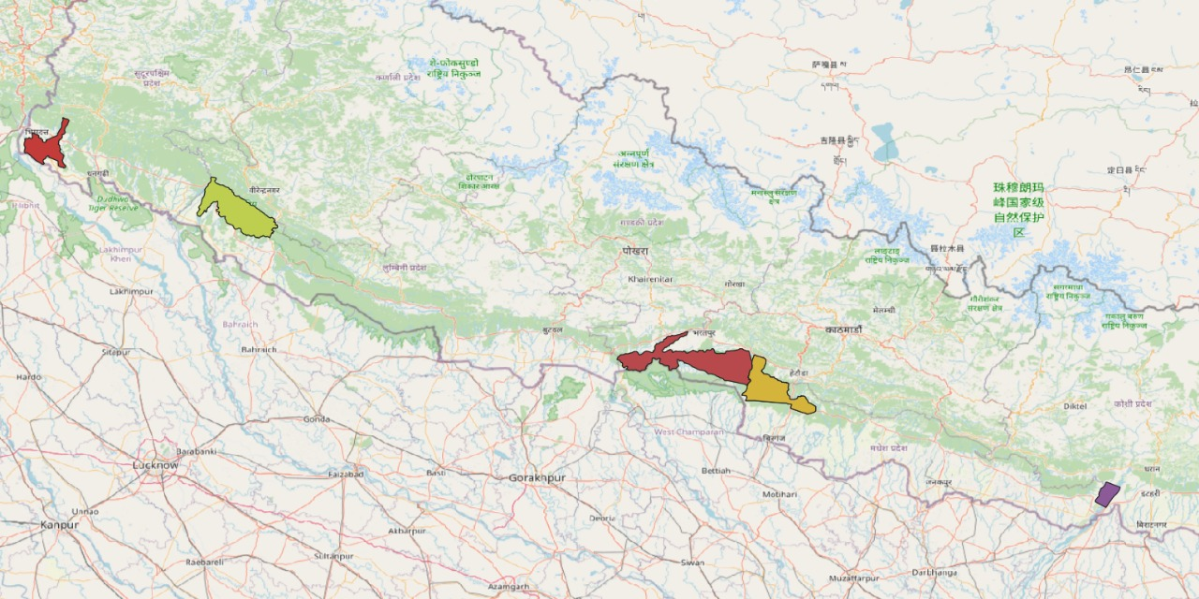
7. Data Processing
Identified Protected Areas:
Shuklaphanta National Park
Bardia National Park
Chitwan National Park
Parsa National Park
Koshi Tappu Wildlife Reserve
Figure 3: National Parks and Reserves Highlighted for Analysis.

Slide 12
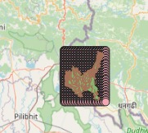
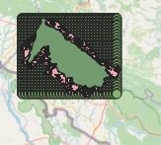

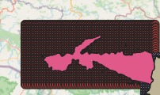
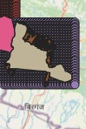
7. Data Processing
Figure 5: Grid View Representation for each National Parks and Reserves .

Slide 13
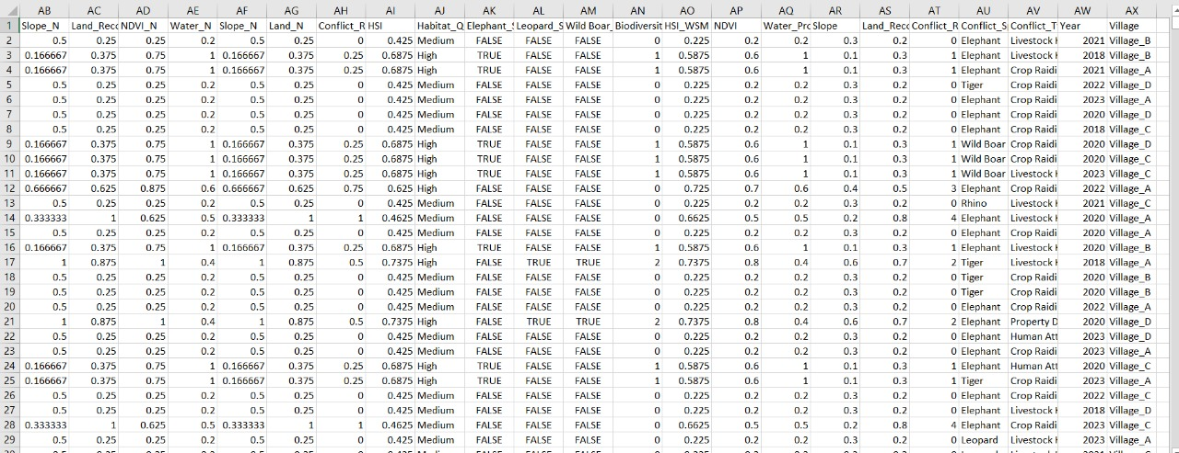
7. Data Processing
Figure 4: Extracted Data for Bardia National Park.

Slide 14
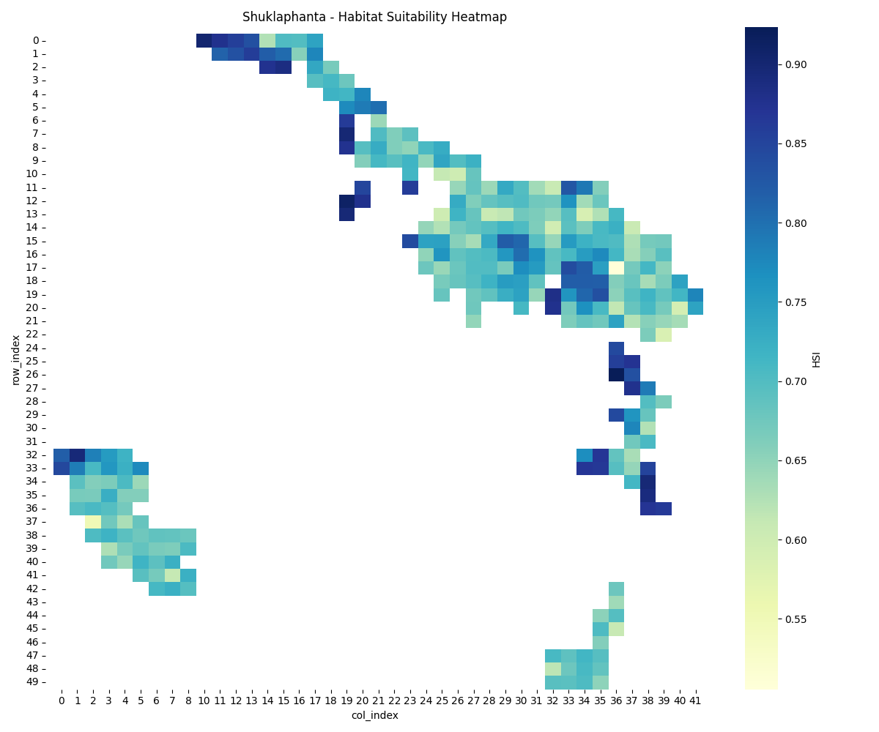

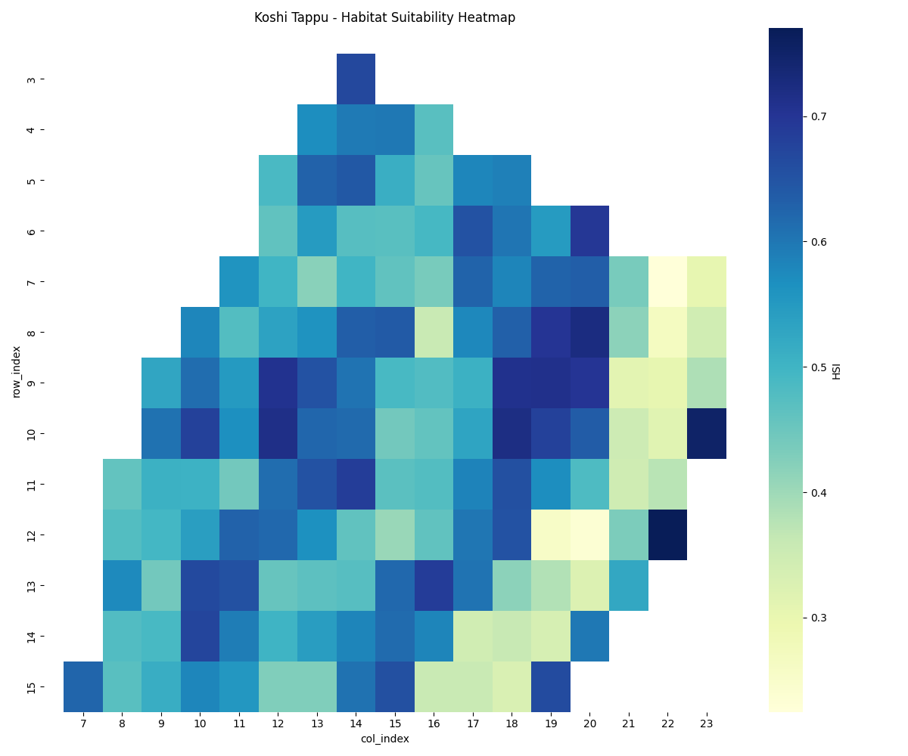
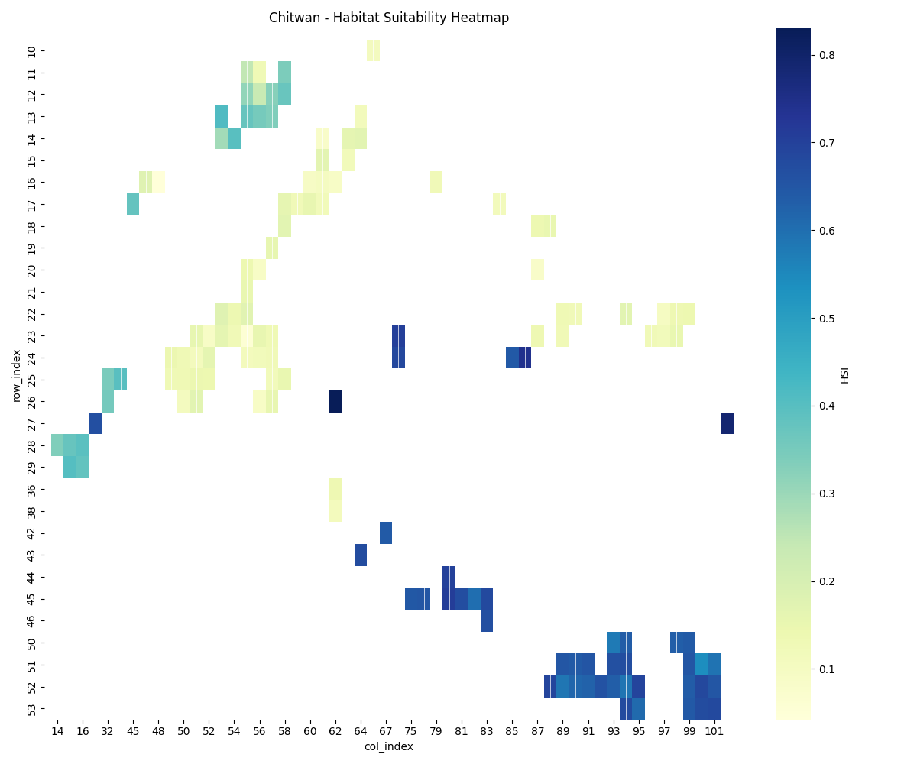
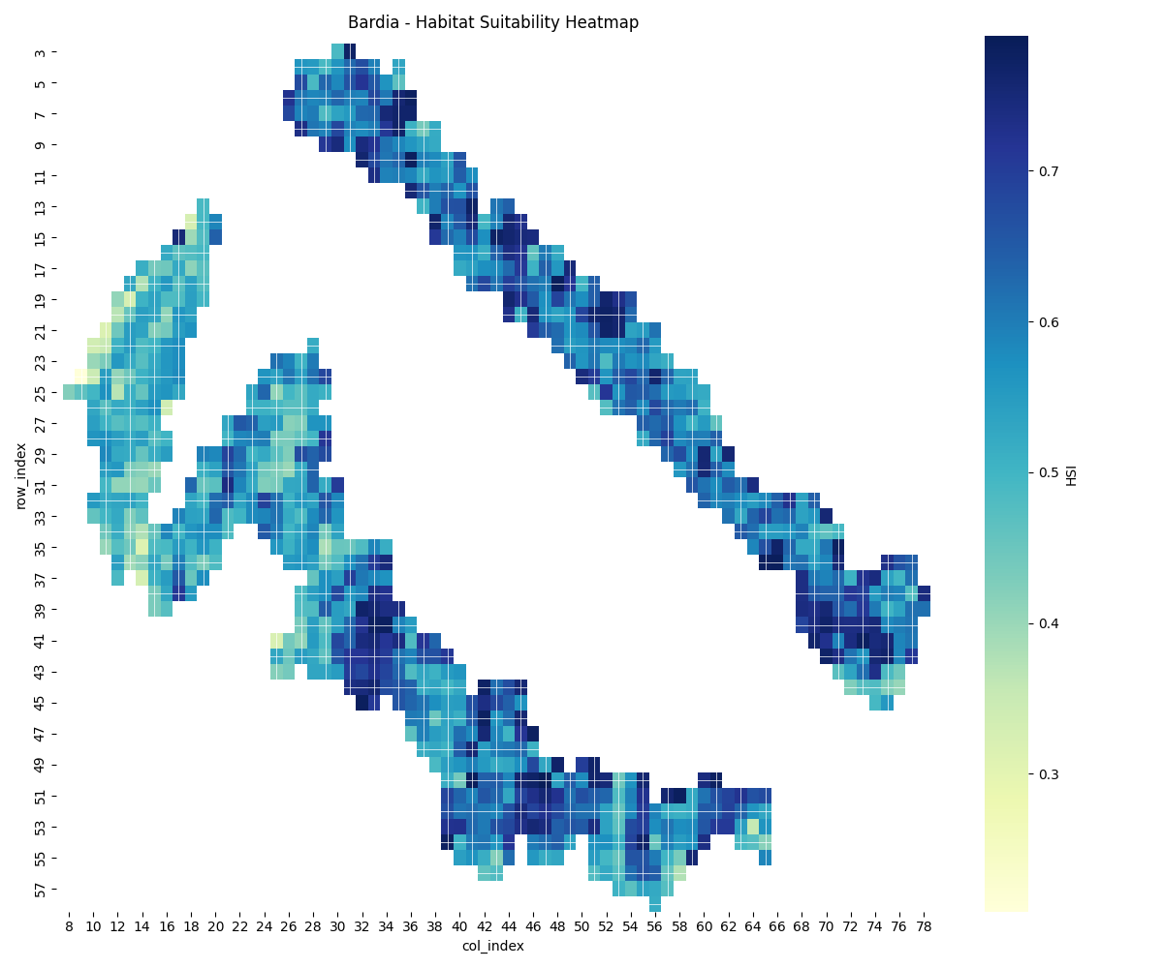
8. Habitat Sustainablity Index
Figure 5: Habitat Suitability Index (HSI) Heatmap

Slide 15
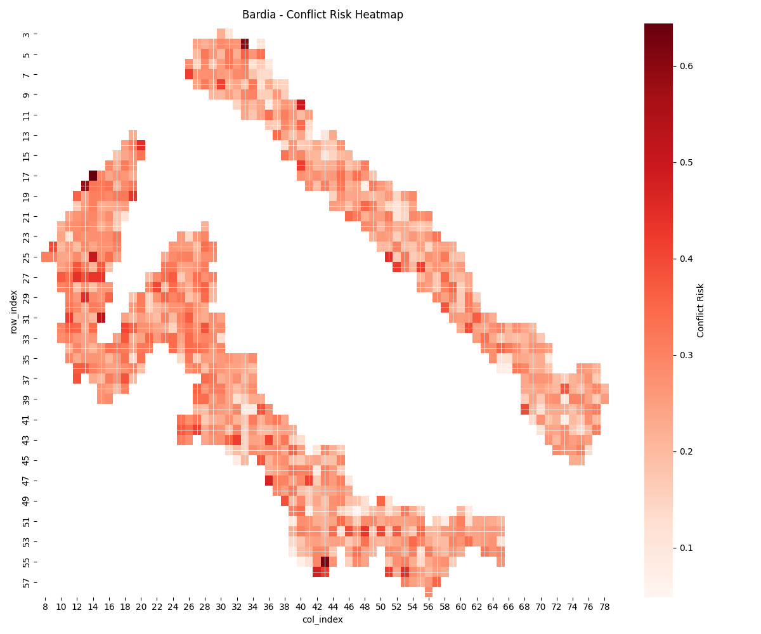
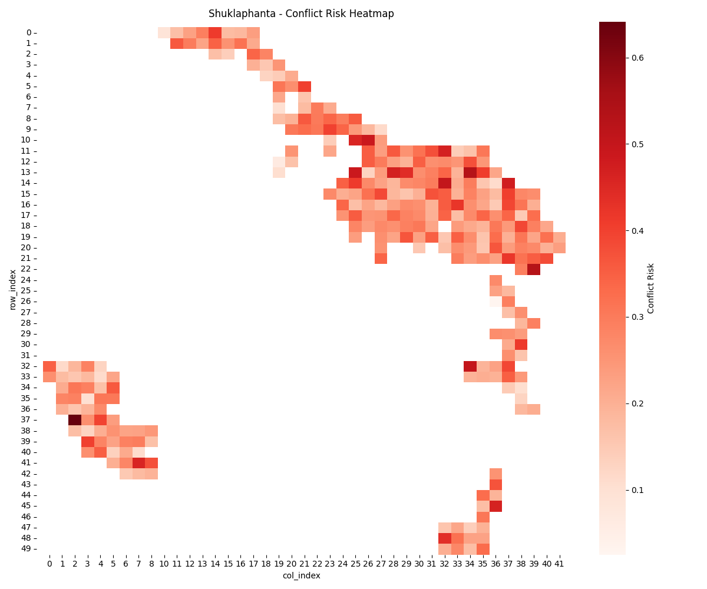

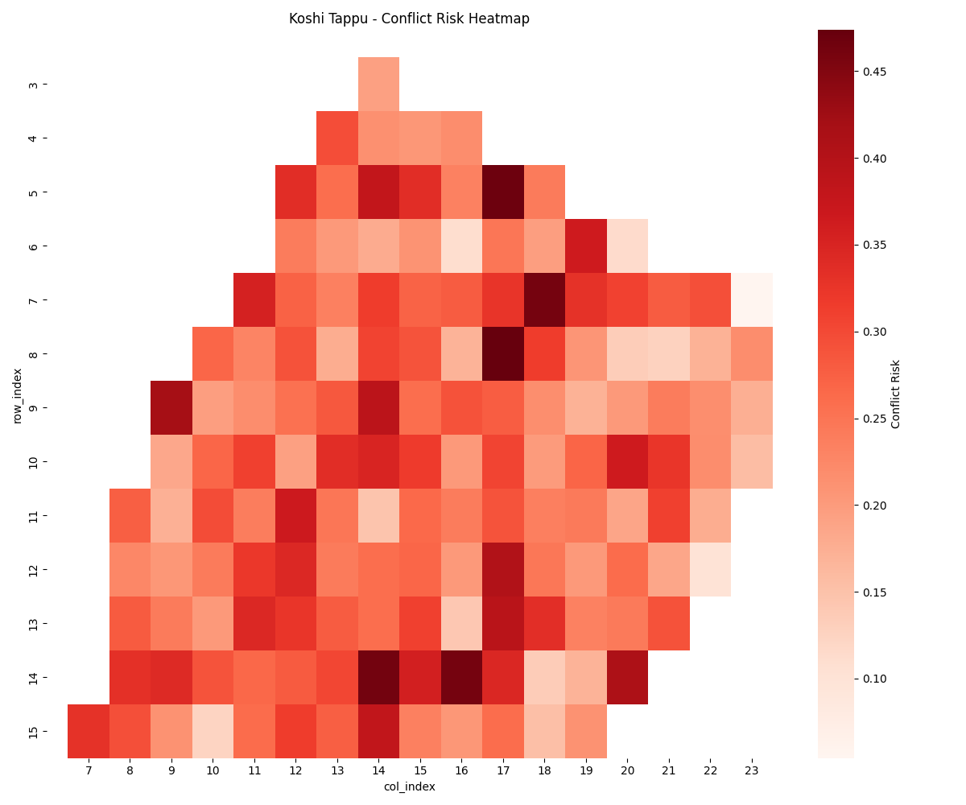
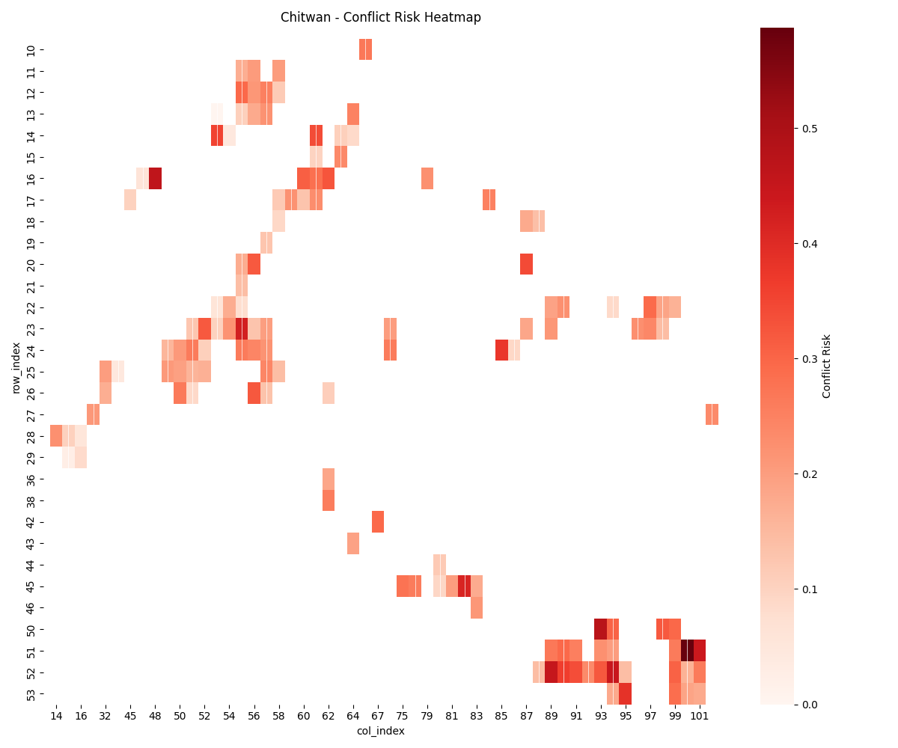
9. Conflict Risk Zone and Hotspots
Figure 6: Conflict Risk Heatmaps.

Slide 16
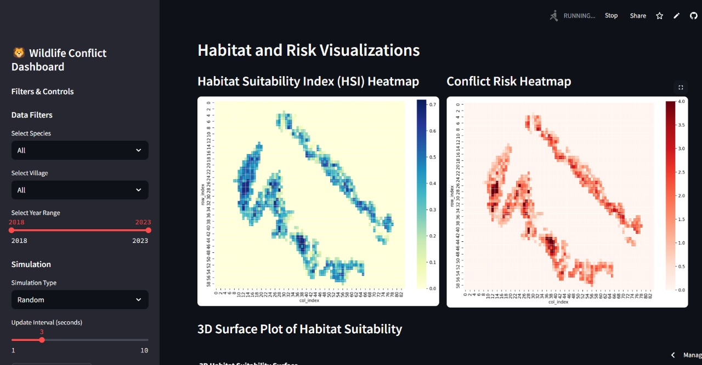
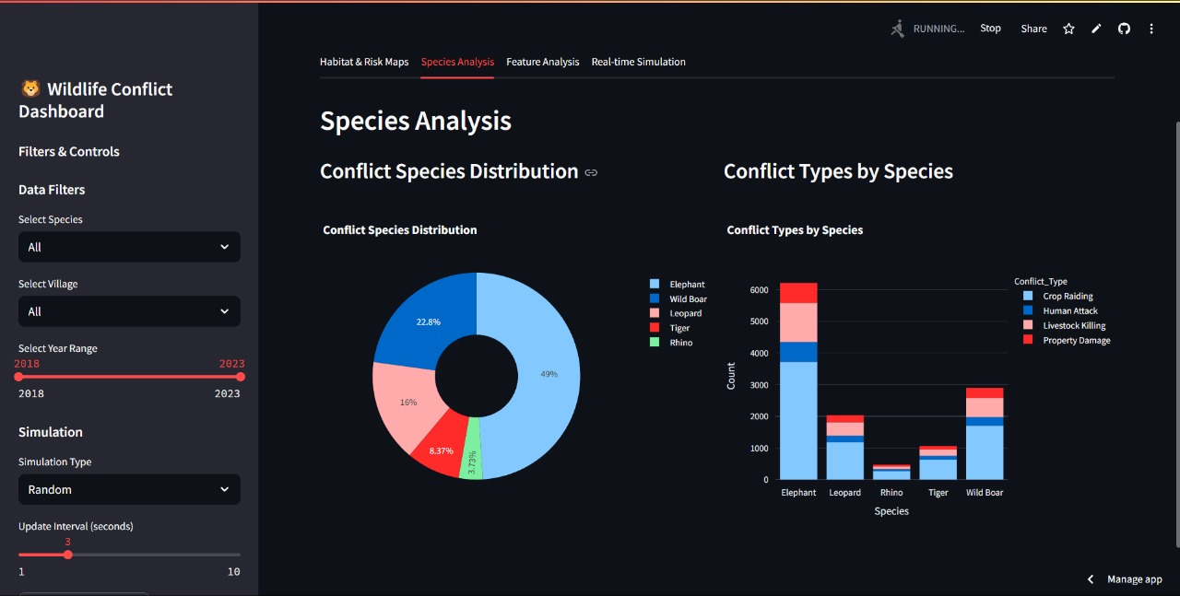
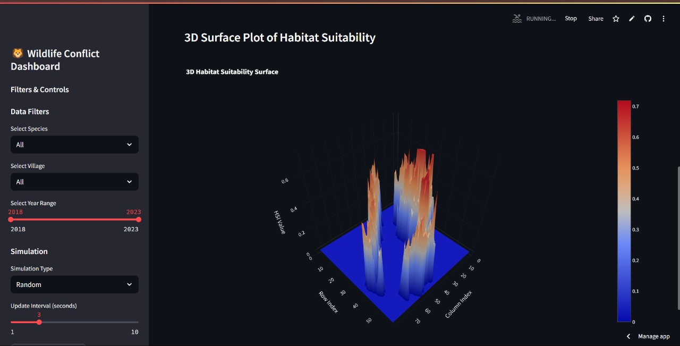
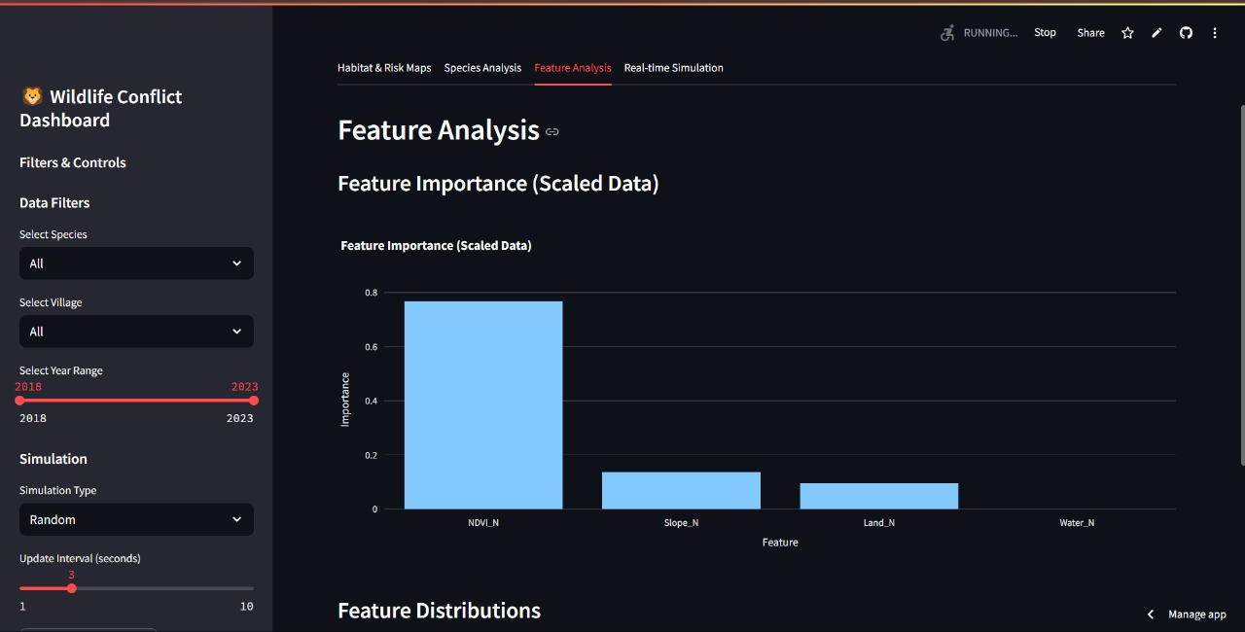
10. Streamlit Dashboard
Figure 7: Model Output Visualization.

Slide 17
References
Rautela, N., Shanu, S., Agarwal, A., Bhattacharya, S., & Roy, A. (2022). Geospatial modelling of overlapping habitats for identification of tiger corridor networks in the Terai Arc landscape of India. Geocarto International. https://doi.org/10.1080/10106049.2022.2095444
de Cock, M. P., Baede, V. O., Wijburg, S. R., Burt, S. A., van Tiel, R. F. N. A., Wiskerke, K., ... & Maas, M. (2024). WILDbase: towards a common database to improve wildlife disease surveillance in Europe. Euro Surveillance, 29(25). https://doi.org/10.2807/1560-7917.ES.2024.29.25.2300617
Wilkinson, V., Richards, S. A., Burgess, L., Næsborg-Nielsen, C., Gutwein, K., Vermaak, Y., ... & Carver, S. (2024). Adaptive interventions for advancing in situ wildlife disease management. Ecological Applications. https://doi.org/10.1002/eap.3019
McEachran, M. C., Harvey, J. A., Mummah, R. O., Bletz, M. C., Teitelbaum, C. S., Rosenblatt, E., ... & Cook, J. D. (2024). Reframing wildlife disease management problems with decision analysis. Conservation Biology. https://doi.org/10.1111/cobi.14284
Animal Health Journal. (n.d.). Impact of Climate Change on Vector-Borne Diseases in Wildlife. Animal Health Journal (AHJ). [Cover Image Source]
IUCN SSC. (2023). IUCN SSC guidelines on human-wildlife conflict and coexistence (First edition). International Union for Conservation of Nature (IUCN). [https://www.iucn.org]
Joshi, A., & Singh, P. (2018). GIS-based predictive modeling for human-animal conflict zones. Wildlife Conservation Journal, 12(3), 45–59.
National Tiger Conservation Authority (NTCA). (2018). Status of Tigers, Co-predators and Prey in India. Government of India. [https://projecttiger.nic.in]

Slide 18
Thankyou !

